Slide 1

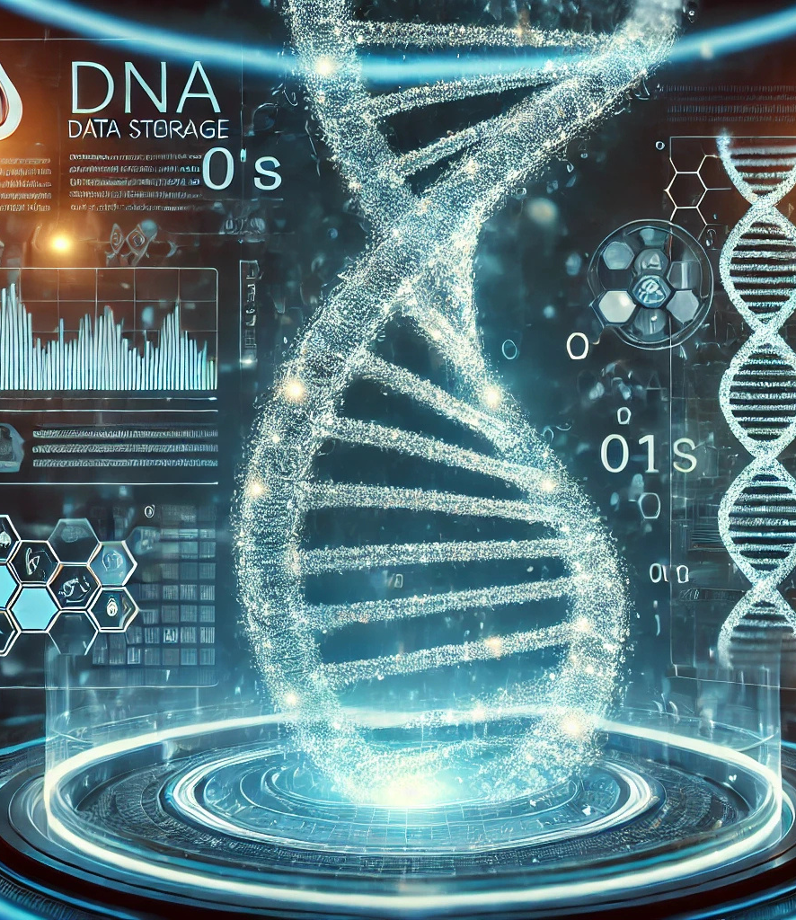
BVERSITY
Image Storage and Retrieval Using DNA Encoding
A Novel Approach to Data Storage

Slide 2
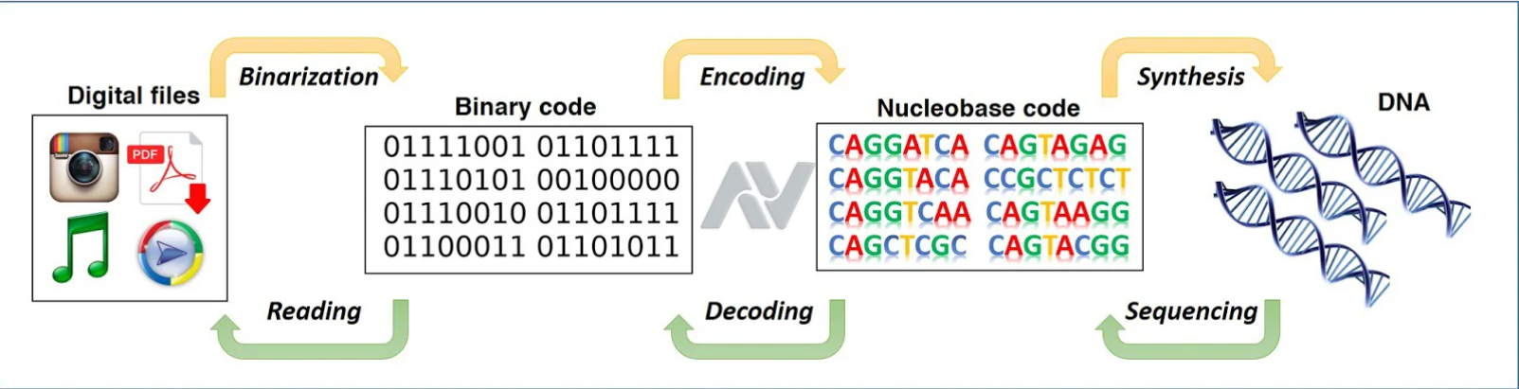
DNA Data Storage – Synthetic DNA – Future Of Storage

Slide 3
3
01
02
03
Convert Digital Image to Binary
Encode Binary Data into DNA
Decode DNA Back to Binary
04
Convert Binary Back to Image
STEPS
TO FOLLOW FOR DNA DATA STORAGE

Slide 4

Convert Digital Image to Binary
4
Function: file_to_binary(file_path, output_binary="binary_output.txt")
Reads a file in binary mode
Converts bytes into an 8-bit binary format
Saves binary data as a text file

Slide 5


Encode Binary Data into DNA
Function: binary_to_dna(binary_file, dna_output="dna_output.txt")
Maps 2-bit binary pairs to DNA bases:
00 → A
01 → C
10 → G
11 → T
Saves the DNA sequence to a file
5

Slide 6
6
Decode DNA Back to Binary
Function: dna_to_binary(dna_file, binary_output="restored_binary.txt")
Converts DNA bases back to binary
Uses reverse mapping:
A → 00
C → 01
G → 10
T → 11

Slide 7


7
Function: binary_to_file(binary_file, output_file)
Converts binary back to its original file format
Convert Binary Back to Image

Slide 8
8
RUNNING THE CODE
CONVERT
FILE TO DNA
RESTORE
DNA TO FILE
python script.py input_file
python restore_script.py dna_file output_file

Slide 9
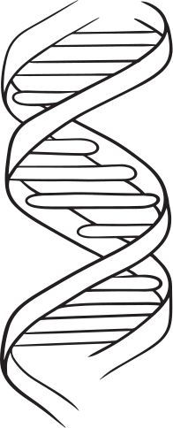
9
Applications & Future Scope
DNA-based data storage for long-term archiving
High-density storage potential
Bioinformatics and computational biology applications

Slide 10

"It's not about the outcome, but the effort and understanding you gain along the way. True growth lies in the journey, not just the destination."
10
Thank you !!

